Slide 1
Review

Slide 2
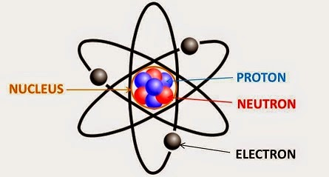
Review
Draw a model of an atom and label all its components.

Slide 3
Review
2. How is the atomic mass calculated?
Number of neutron + number of neutrons
p+ + n⁰ = atomic mass

Slide 4
Review
3. What id an isotope?
Different number of neutrons and protons in the nucleus
4. Write one example of an isotope in isotope notation.

